Slide 1
Build a Test Lab Environment
Ben Dumke
Notes:
Jeffery Snover Interview – Recounts TechEd 2010 meeting a guy that gets 17% raise due to learning PowerShell
Why do I bring this up?
Labs are about learning and testing

Slide 2
3 Goals
Setup One Pilot Device
Pick One Learning Topic
Build One Lab

Slide 3
Agenda
Pilot Lab – Set of resources for testing change
Learning Lab – Isolated resources for learning new skills
Notes:
The two broad topics to cover are pilot lab and a learning lab.
Pilot – small group of VM’s and users to test policies, installs, and settings in a separate OU or group that closely matches your environment
Learning – separate environment with the goal of learning new skills.

Slide 4
Why Do You Need a Lab?
Test – What if?
Learn – New skills without impact
Practice – Repeat in controlled manner
Notes:
Test – Even one PC or VM can make a difference. What happens when a use logs into the PC? Will this new version of software install properly? Are the settings in this GPO applying properly?
Learn – If you want to learn new skills a lab is a must. Learning Config Manager or testing Group Policy is not something that you should be doing in your production network.
Practice – Having an environment were you can repeat process in a controlled manner is incredibly important. Repeating the steps gives you an idea of how long a task should take, get you familiar with the steps and the UI, perform installs of services that are normally “one-time” events such as, DHCP, AD, and DNS setup, and helps you weed out bad information when troubleshooting similar problems.

Slide 5
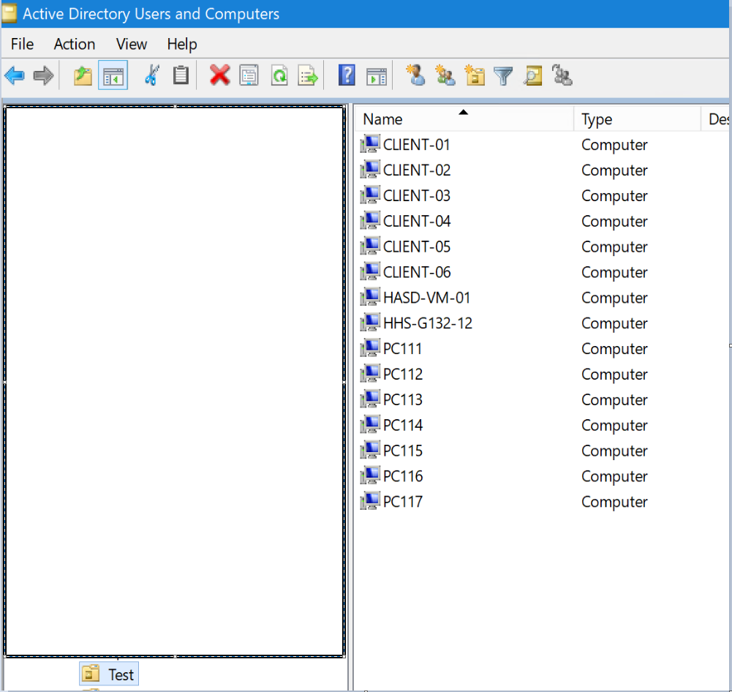
Pilot Lab
Test VMs
Setup just like your physical PC’s
Physical PC’s
Save Models on Refresh
Purchase Spares
Notes:
At a minimum you should have a few spare PC’s that are similar to your production PC’s or a few VM’s with your client image installed. This allows you to at least test some scenarios without putting your entire environment at risk.
I have several VM’s setup in a separate OU. I have them added to a MEMCM Device Collection. I can apply software, test updates, and test deployments.

Slide 6
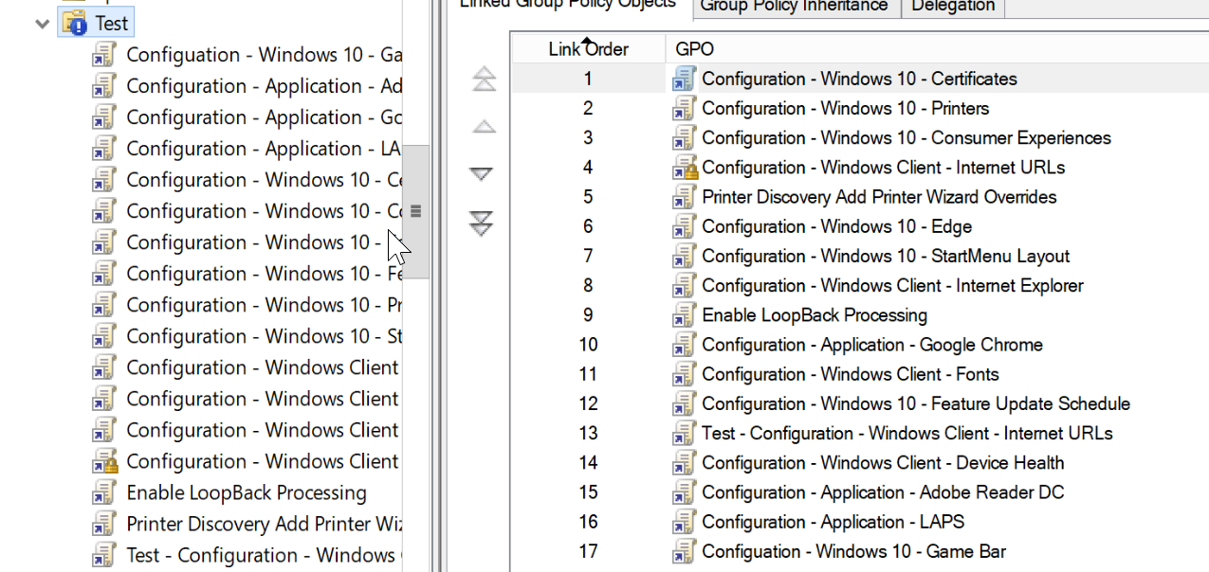
Pilot Lab
AD Setup
Add to Test OU
Block GPO Inheritance
Apply Baseline GPO’s
Notes:
Test OU
Assign a baseline config

Slide 7
Pilot Users
Faculty Accounts
Student Accounts
Notes:
Test user settings
Issue this year with Fast User Switching. Teacher reported that Fast User Switching was logging her off. I used my test teacher account to login, lock the workstation and have the teacher have the teacher test.
Testing permissions to folders and shares.
Testing content filter settings.

Slide 8
Demo
DELETED VIDEO TO SAVE SPACE

Slide 9
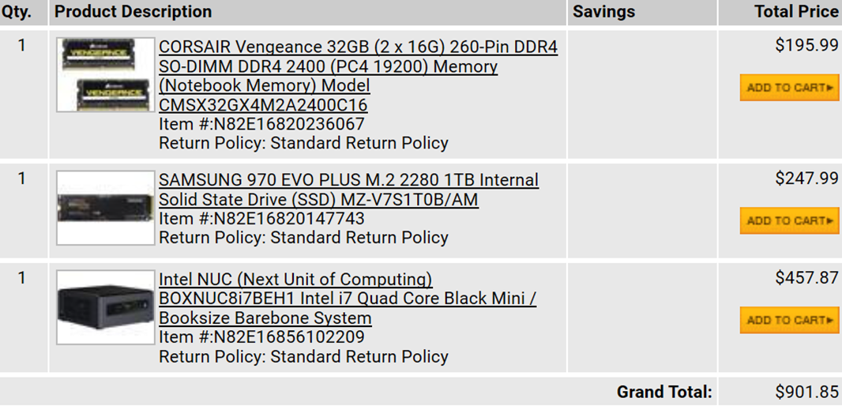
What Do You Need for a Learning Lab?
Hypervisor
RAM
SSD/NVMe
OPTIONAL
Switch
Additional PC’s
Notes:
A true lab should be a self-contained PC running a hypervisor. Hyper-V, VMWare, VirtualBox are all fine solutions. Personally, I use Hyper-V on Windows 10 or Windows Server. You should have at least 32 GB of RAM and an SSD or NVMe drive.
A physical switch and physical PC’s can be a nice addition especially if you are working with deploying Windows. As you can see from the NewEgg cart I grabbed, a lab PC can be very affordable.

Slide 10
Manually Build a Lab
Pros
Cons
Learn by doing
Better troubleshooting
Time
Errors
Can’t replicate
https://www.osdsune.com/home/blog/2020/configmgr-lab

Slide 11
Automatically Build a Lab
Pros
Cons
Fast
Easy setup
Consistent
Done for You

Slide 12
What about the Cloud?
Pros
Cons
No Upfront Costs
Recurring Costs

Slide 13
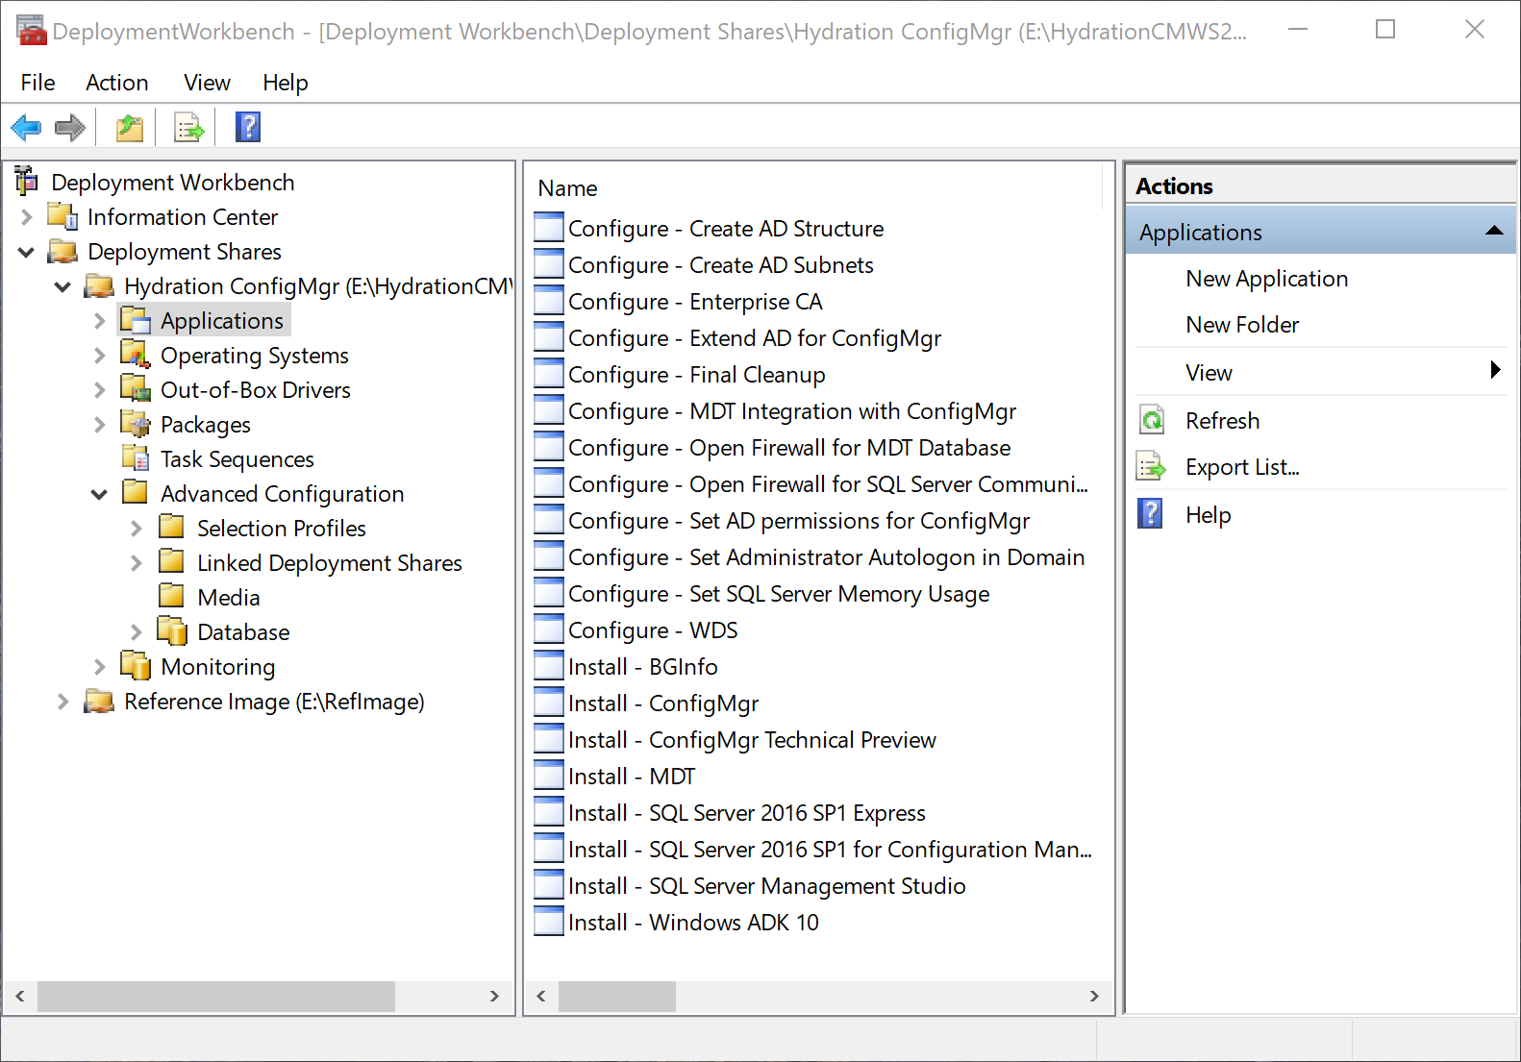
Learning Lab – Hydration Kit
Install Windows 10 ADK
Deployment Tools
Windows PE
Install Deployment Toolkit
Extract and Run the Hydration Kit Scripts
Populate Deployment Share
Create Deployment Media
https://deploymentresearch.com/
Notes:
The easiest way to create your proof of concept or test environment is with a Hydration Kit. Kits are available with the guide books we just showed or deploymentresearch.com. The Hydration Kits are a set of scripts that enable you to build a test lab in three easy steps:
Download the necessary software
Prepare the Deployment Environment
Deploy the virtual machines
What does this look like in more detail? First install Windows 10 ADK and MDT. Extract and run the Hydration Kit Scripts. Download and copy the necessary installation files, Windows Server, Client, SQL, SCCM, Office, etc. to the proper folders in the Deployment Toolkit share. Once the files are copied, start Deployment Workbench, open your Deployment Share, under Advanced Configuration, Media, right-click and choose update media. This will create a bootable ISO file containing all of the files, scripts and Task Sequences in the share. Once the ISO is done we can deploy the lab.

Slide 14
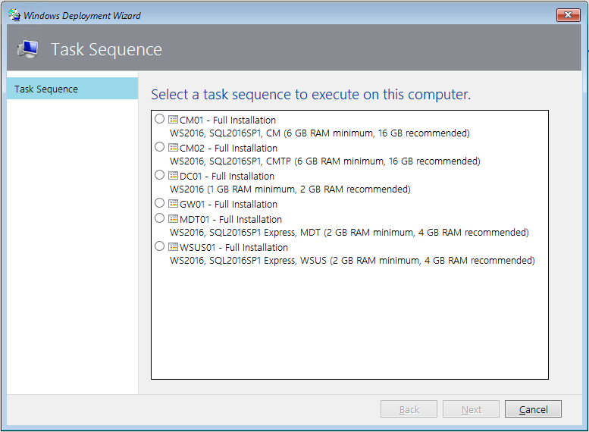
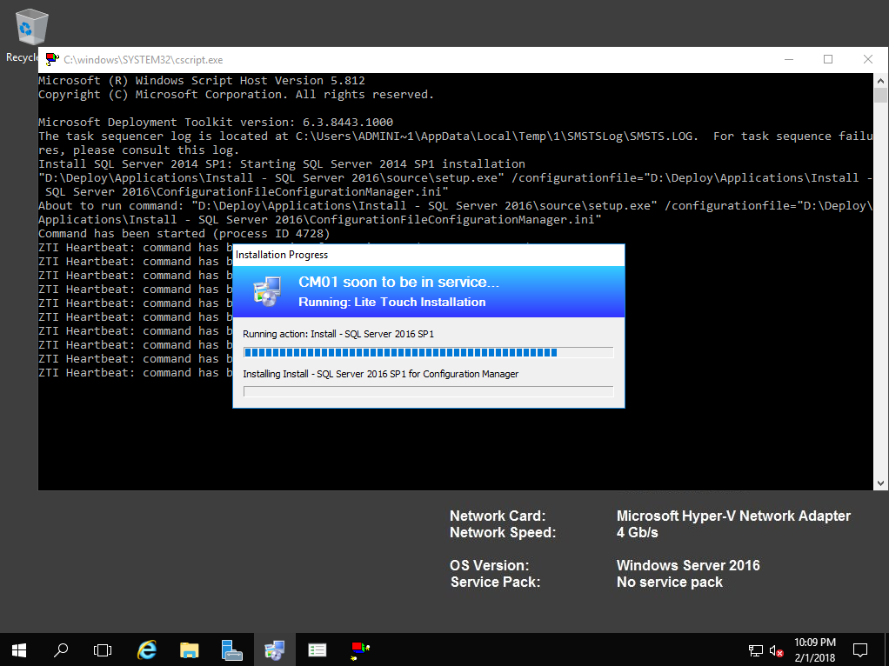
Learning Lab – Deployment
Create the Virtual Machines
Domain Controller
SCCM Server
Mount the ISO
Start the Domain Controller Task Sequence/Run Configuration Scripts
Start the Remaining Task Sequences
Go to Lunch
Notes:
Use either the PowerShell script for Hyper-V or manually create the following VM’s.
Deploying DC01
Using Hyper-V Manager or VMware Sphere, create a virtual machine with the following settings:
Start the DC01 virtual machine. After booting from HydrationCM.iso , and after WinPE has loaded, select the DC01 task sequence. Wait until the setup is complete and you see the Hydration Complete message in the final summary. Leave DC01 running while deploying the CM01 virtual machine.
Setup any other VM’s the guide calls for and go to lunch. Setup will complete in 30 – 60 minutes depending on how many VM’s are installing and the speed of your hardware.
Now you have your proof of concept environment. You are ready to test image creation, deployments, and other SCCM functions.

Slide 15
Demo
Johan’s Hydration Kit

Slide 16
Learning Lab - WSLab
Designed by Jaromir Kaspar PFE
Only needs a few PowerShell scripts and an ISO
Setup is very fast, just a few minutes after the initial setup
Many scenarios
FREE
http://aka.ms/wslab

Slide 17
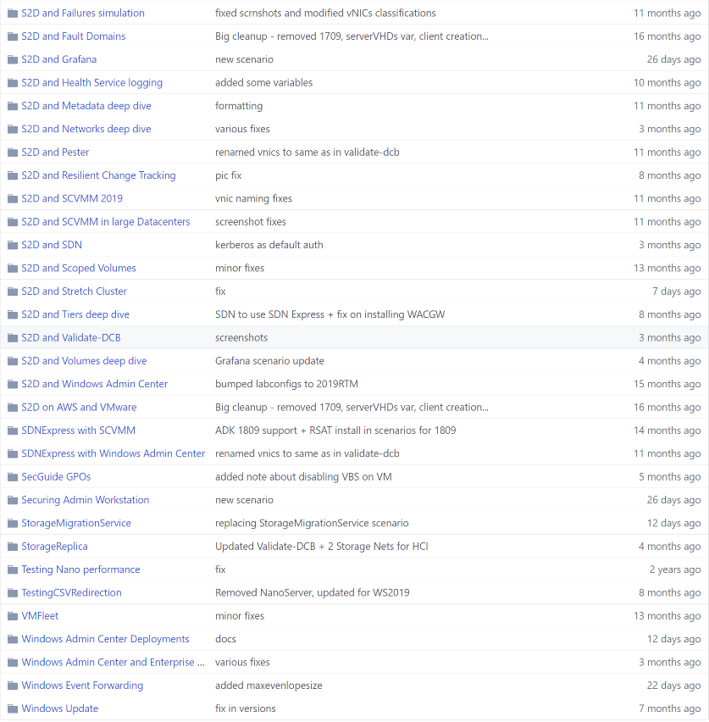
Learning Lab - WSLab

Slide 18
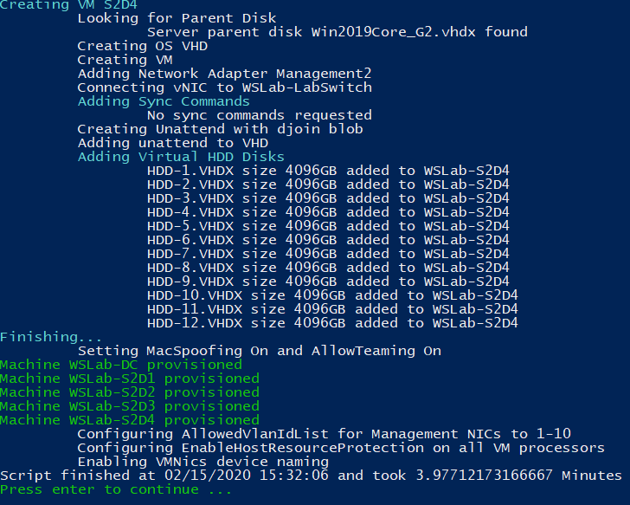
Demo
Jaromir’s Security Scenario

Slide 19
Learning Lab – Microsoft Deployment Lab
Download and run
Guidebook – 264 pages
Very comprehensive
Expires every few months
Focused on Microsoft topics
Notes:
BIOS to UEFI
Bitlocker
USMT
Servicing

Slide 20
Learning Lab – VMWare Resources
VMWare
VMUG Advantage - $200 per year plus free NFR Software
https://www.virtuallyghetto.com/home-lab
http://hol.vmware.com/
http://www.labguides.com/

Slide 21
3 Goals
Setup One Pilot Device
Pick One Learning Topic
Build One Lab

Slide 22
Resources – Even More Labs
https://docs.microsoft.com/en-us/microsoft-365/enterprise/modern-desktop-deployment-and-management-lab
https://github.com/outflanknl/Invoke-ADLabDeployer
https://techcommunity.microsoft.com/t5/ITOps-Talk-Blog/Step-By-Step-Building-a-Hyper-V-Lab-in-Azure-with-Windows-Server/ba-p/1048762
https://github.com/dkawula/Surviving-a-Ransomware-Attack-Using-Azure-Site-Recovery
https://github.com/microsoft/ignite-learning-paths-training
https://automatedlab.org/
https://amicasto.com/2019/12/22/meat-and-potatoes-finding-affordable-hardware-for-your-configmgr-lab/
https://github.com/themichaelbender/demos/tree/master/presentations/Altaro-Azure-Certification

